Slide 1

MineSafe : IOT Based Smart Helmet for Mining Workers
by
J.R.Yashaswini
Roll No. 204G1A05C5
P. Pavan
Roll No. 204G1A0571
M.Tufel Basha
Roll No. 204G1A05B3
P.Divya
Roll No. 194G1A0528
Under the guidance of
Mr. P. Praneel Kumar, M.Tech., (Ph.D),
Assistant Professor
Department of Computer Science and Engineering
Srinivasa Ramanujan Institute of Technology
(Autonomus)
2023 - 2024

Slide 2
Contents
Abstract
Problem statement
Objectives of Project
Methodology
Expected Outcomes
Field of Application of Project
Tentative Work Plan
Queries

Slide 3
Abstract
Mining is recognized as one of the most hazardous occupations in the world. The mining industry has the highest incidence of occupational deaths. In order to reduce these risks and make mining safer, we are focusing on improving the helmets used by workers.
Therefore, the main aim is to make the helmet even safer by adding an array of sensors to monitor environmental conditions, an emergency switch to trigger an alert in case of emergencies, GPS location tracking, along with a WiFi module for IoT communication. Additionally, the helmet incorporates an Mems Sensor for fall detection, as well as a pre-recorded voice provided by a voice processor for alerts. The developed helmet system is primarily intended to improve the working environment in mines and ensure worker safety.
Keywords : Smart Helmet, Sensors, GSM, GPS, Voice Processor.

Slide 4
Problem Statement
In underground mining there is a concern about the safety of the workers due to its highly changing environment. Thousands of miners die from mining accidents every year.
To save the workers life and to improve safety in mining environment it is important to take some safety measures and to improve communication between workers and control stations to avoid life threatening situations.
With the help of the smart helmet we can provide security and rescue measures in case of any emergency conditions.

Slide 5
Objectives of Project
Research Objective - 1: To develop an advanced smart helmet system with a diverse set of sensors, including environmental sensors (such as gas, temperature, and humidity), Mems sensor for fall detection, IR sensor for helmet usage verification and Heart Rate sensor to measure the heart pulse rate.
Research Objective - 2: To Implement an intelligent alert system using voice notifications through the APR33A3 voice playback module.

Slide 6
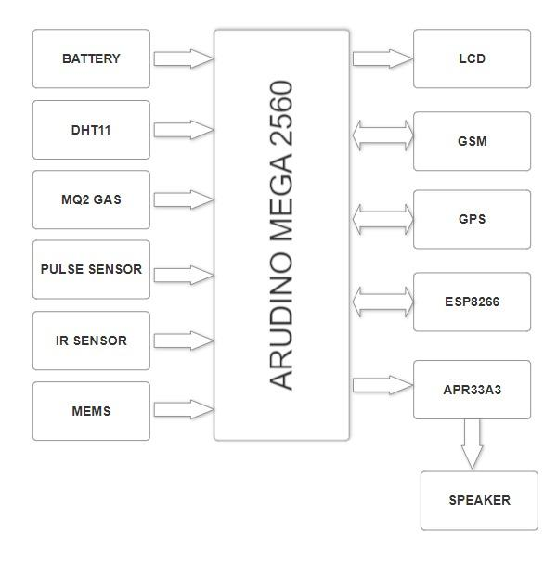
Proposed System
Fig-1: Block diagram of Proposed System

Slide 7
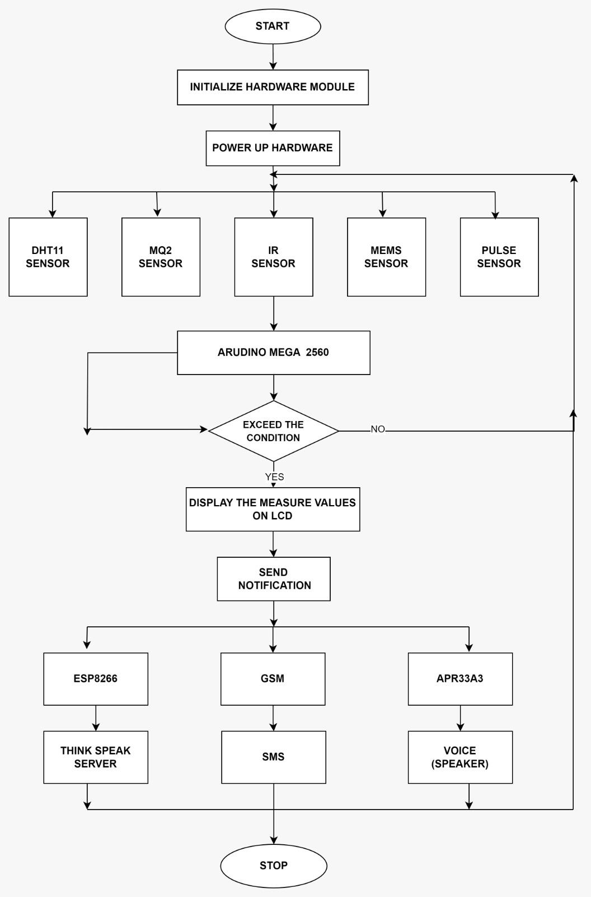
Proposed System
Fig-2: Flow Chart of Proposed System

Slide 8
Methodology
This project is to design a smart helmet to ensure the well-being of workers and to protect them from potential health hazards. The helmet incorporates a range of specialized sensors to monitor both environmental conditions and workers health. When an abnormal condition is detected by the sensors, It notifies the workers and co-workers through a sound by specifying the exact cause and also sends a SMS to the registered mobile number along with the live location of the worker.

Slide 9
Methodology Contd…
Module-1: Environmental Monitoring
This module focuses on monitoring the external environment to ensure the safety of miners. It incorporates sensors such as Gas Sensor, Temperature and Humidity Sensor. The Gas Sensor is utilized to detect harmful gases, while the Temperature and Humidity Sensor assesses environmental conditions. The data from these sensors are processed by a central microcontroller. And alerts are communicated to miners through LED and through a sound by specifying the exact cause. The system utilizes GSM technology for external communication to send real-time updates and alerts to relevant personnel.

Slide 10
Methodology Contd…
Module-2: Worker Health Monitoring
This module involves monitoring the health conditions of workers within the mining environment. IR Sensor is integrated to confirm the worker is wearing the helmet. while Heart Rate, Accelerometer and Gyroscope sensors continuously monitor workers heart rate, movements and orientation. The collected data is processed by the central Arduino microcontroller to assess the well-being of miners. In case of irregularities or potential health hazards, the system triggers alerts, communicated through a voice interface to provide real-time guidance. The use of GSM ensures that critical information can be communicated swiftly to supervisors or emergency response teams.

Slide 11
Methodology Contd…
Module-3: Emergency Response System
This module focuses on providing an efficient emergency response system for miners. An integrated emergency button allows miners to request help rapidly. The system utilizes GPS technology to pinpoint the exact location of the miner in distress. Instead of traditional loud alarms, the smart helmet communicates essential information through a voice interface, offering real-time updates and guidance during emergency situations. GSM technology is employed for external communication, ensuring that alerts and location information are promptly transmitted to the relevant personnel for immediate assistance.

Slide 12
Expected Outcome
The system utilizes set of environmental sensors to detect environmental conditions and additional sensors to monitor the workers well-being. Upon detecting an abnormal condition, the system promptly notifies the workers through audible alerts specifying the exact cause. Additionally, it sends an alert message to the registered mobile number, including the live location of the worker, to facilitate swift rescue in case of emergencies.

Slide 13
Field of Application of Project
Our project's primary application is in enhancing occupational safety within the mining industry, utilizing a smart helmet with sensors, GPS, and IoT communication for real-time monitoring and emergency alerts. It aims to significantly reduce risks and improve the overall working environment for mine workers.

Slide 14
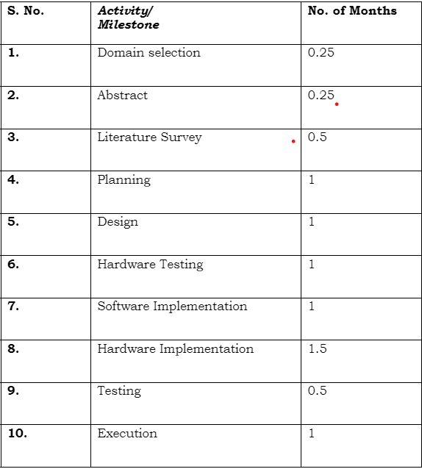
Tentative Work Plan
Activity Plan :

Slide 15
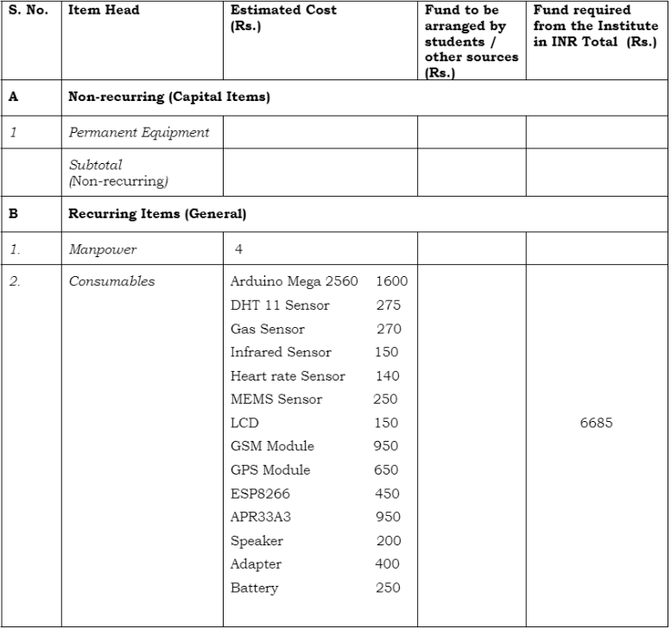
Estimated Budget

Slide 16
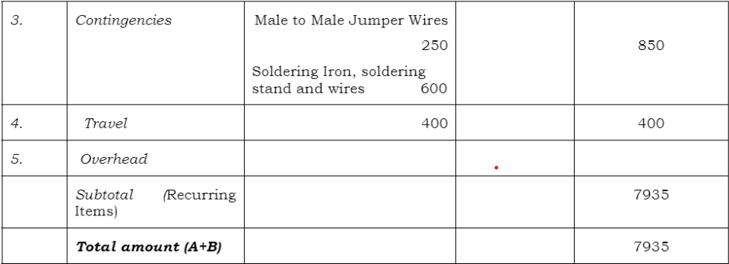
Estimated Budget

Slide 17
Any Queries?

